Slide 1


Slide 2

#LifeKoKaroLift
SGC Coaching:
Articulate your Journey | Activate Students’ Vigour| Accelerate Mutual Growth
Session 7
Linear Regression

Slide 3
Agenda
Quick Recap – (15 mins)
Focused Teaching – (50 mins)
Last 2 weeks
Deep-Dive: Simple/Multiple Linear Regression
Review - Notebooks
Doubt resolution –(25 mins)

Slide 4
Recap: What the learner have learnt in the week
Quick Glance at Key Learnings
ML Techniques
Supervised Learning
Regression methods
Simple/multiple
Model Optimization
Performance tuning
Unsupervised Learning
Assumptions
Application
Gradient Descent

Slide 5
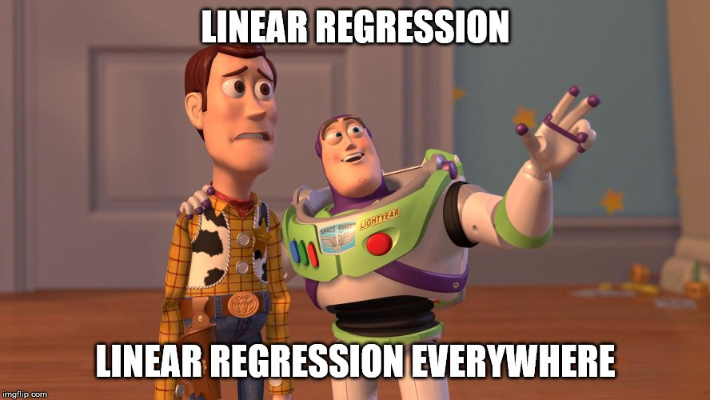
Meme: Linear Regression

Slide 6
Focussed teaching: Deep-Dive of Linear Regression
Business Cases (Why?)
Technique related considerations (When, where, how?)
Coding in Python (Actual coding methods)
Interview Questions

Slide 7

Potential Solutions Leveraging Linear Regression
Y = ß₀ + ß₁x_{1.....} + ß_{n}x_{n}
Analytics Solutions:
Business Growth Drivers
Category Landscape Assessment
Marketing Mix Modelling
Business Questions Addressed:
Why is my product x not growing?
What are category growth drivers?
How can I improve my Marketing ROI from key brands?
Combination of diagnostics and statistical approach to arrive at most optimum model.
Discuss actionability of parameters as an outcome of the model
Notes:
Explain Business context with above examples and your own industry experience
More details needed for business users, but other groups also need to understand applications.

Slide 8
Technique Considerations (Concept & application)
Choose right model type
Cross-section vs. Time Series (Data)
Simple vs. Multiple
Inspect limitations/ assumptions
Specification bias
Multicollinearity
Enhance model quality
R² vs Adjusted R²
RMSE/ MAPE
Features (Non-Linear /Categorical)
Normality
Observation count
Autocorrelation
Heteroscedasticity
Cost Function
AIC/BIC
P-value/ F-Value
Multi-channels/ regions (Mixed)
Key Assumptions of Linear Regression
Notes:
Things to consider (Ideal vs. Real): Especially relevant for Tech background who have little experience in statistics.
Specification bias- Error in using right dependent and independent variables
Normality- Check for normal distribution to avoid bias
Multicollinearity- Variables must be independent of each other. Check correlation matrix
Autocorrelation- Autocorrelated dependent also results in autocorrelated error.
Heteroscedasticity- Check for homogeneity of data to reduce variance of output.
Observation count- Allow sufficient degrees of freedom and sample sufficiency.
Model quality options must be compared to each other to explain utility.
Some explanation on ML iterative mechanism will be helpful.

Slide 9
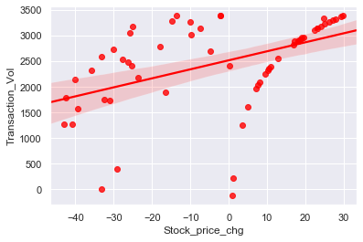
Meaningful interpretation using Python
Model Interpretations
Visualization: You can use regplot for simple linear regression
What do you infer?
How do you analyse Multiple Linear regression outputs?
print(fit().summary())
Optimum fit analysis
Notes:
Show your own outputs in coding and explain each outcome carefully.

Slide 10
Focussed teaching: Let’s Code Together
Coding Time

Slide 11
Focussed teaching: Let’s Code Together
Quiz Time
Notes:
https://forms.gle/njYNkY4s7MwFWaPa6

Slide 12

Doubt resolution
Address Questions
On Technique
On Applications
Anything else
Notes:
Encourage Within group Interactions

